Slide 1
http://www.vidyanidhi.com/
ketkiacharya.net@gmail.com
Ketki Acharya
From: SM VITA ATC of CDAC
9769201036
ketkiacharya.net@gmail.com

Slide 2
What Is the .NET Framework?

Slide 3
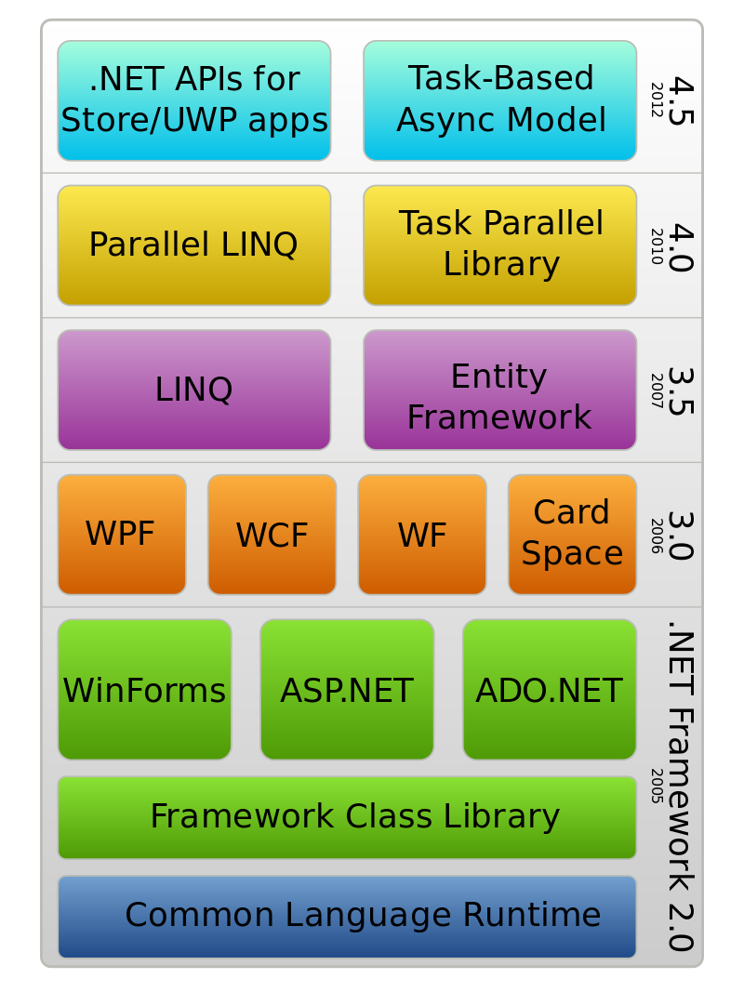
Language Integrated Query to query over dataset, database, Array, collection etc.
It is ORM –Object relational Mapping
Windows Communication Foundation used to create service
Windows Presentation Foundation used for Desktop Application(Use XAML Language)
Active Server Page used for Web Application
Windows Form used for Desktop Application
ActiveX Data Object used for Database connection
Class Library (CL)
FCL
(BCL) Base Class Library

Slide 4
What is the .NET Framework
The .NET Framework defines an environment that supports the development and execution of highly distributed, component-based applications.
The first is the Common Language Runtime (CLR). This is the system that manages the execution of your program. Along with other benefits, the Common Language Runtime is the part of the .NET Framework that enables programs to be portable, supports mixed-language programming, and provides for secure execution.
The second entity is the .NET class library

Slide 5
CLR-MSIL
The Common Language Runtime manages the execution of .NET code.(same as JVM in case of java)
Here is how it works:
When you compile a C# program, the output of the compiler is not executable code. Instead, it is a file that contains a special type of pseudocode called Microsoft Intermediate Language (MSIL). (Same as Byte Code in Java)It is the job of the CLR to translate the intermediate code into executable code when a program is run.
Thus, any program compiled to MSIL can be run in any environment for which the CLR is implemented. This is part of how the .NET Framework achieves portability

Slide 6
JIT
Microsoft Intermediate Language is turned into executable code using a JIT compiler.
“JIT” stands for “Just-In-Time.” The process works like this: When a .NET program is executed,
The CLR activates the JIT compiler. The JIT compiler converts MSIL into native code on demand as each part of your program is needed. Thus, your C# program actually executes as native code even though it is initially compiled into MSIL. This means that your program runs nearly as fast as it would if it had been compiled to native code in the first place, but it gains the portability benefits of MSIL.
In addition to MSIL, one other thing is output when you compile a C# program: metadata.

Slide 7
Metadata
Metadata describes the data used by your program and enables your code to interact easily with other code. The metadata is contained in the same file as the MSIL.

Slide 8
Managed vs. Unmanaged Code
when you write a C# program, you are creating what is called managed code. Managed code is executed under the control of the Common Language Runtime as just described. Because it is running under the control of the CLR, managed code is subject to certain constraints—and derives several benefits. The constraints are easily described and met: the compiler must produce an MSIL file targeted for the CLR (which C# does) and use the .NET class library (which C# does). The benefits of managed code are many, including modern memory management, the ability to mix languages, better security, support for version control, and a clean way for software components to interact.

Slide 9
Unmanaged Code
The opposite of managed code is unmanaged code. Unmanaged code does not execute
under the Common Language Runtime. Thus, all Windows programs prior to the creation of the .NET Framework use unmanaged code. It is possible for managed code and unmanaged code to work together, so the fact that C# generates managed code does not restrict its ability to operate in conjunction with preexisting programs. Pointer in c# is unmanaged code

Slide 10
The Common Language Specification
Although all managed code gains the benefits provided by the CLR, if your code will be used by other programs written in different languages, then for maximum usability, it should adhere to the Common Language Specification (CLS). The CLS describes a set of features that different .NET-compatible languages have in common.
CLS compliance is especially important when creating software components that will be used by other languages.
The CLS includes a subset of the Common Type System (CTS). The CTS defines the rules concerning data types. Of course, C# supports both the CLS and the CTS.

Slide 11
You should be able to Answer the following
What is CLR?
What is MSIL?
What is the use of JIT?
Who read Manage Code?
What is CLS and CTS?
What should I Use for Desk Top Application?
What should I use for Web Application?
What is WCF and explain use of it.

